Slide 1
Natural Language Processing using Neural Nets

Slide 2
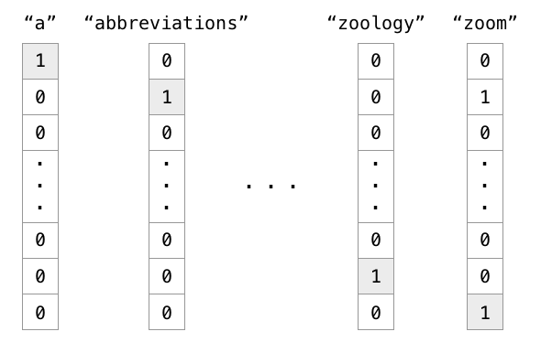
Language representation: one hot vectors

Slide 3
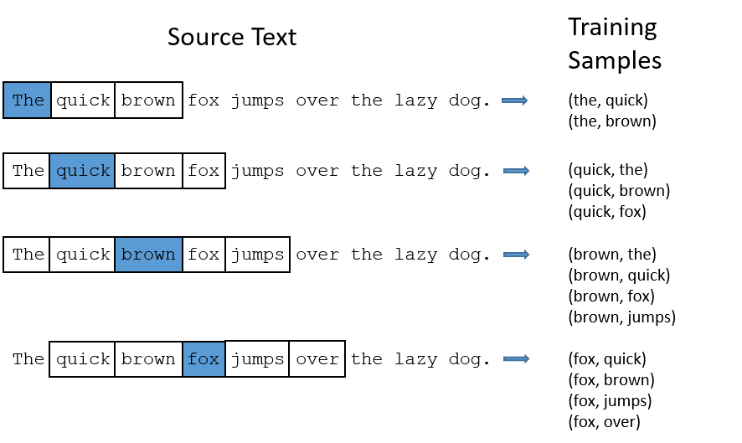
Language representation: context window

Slide 4
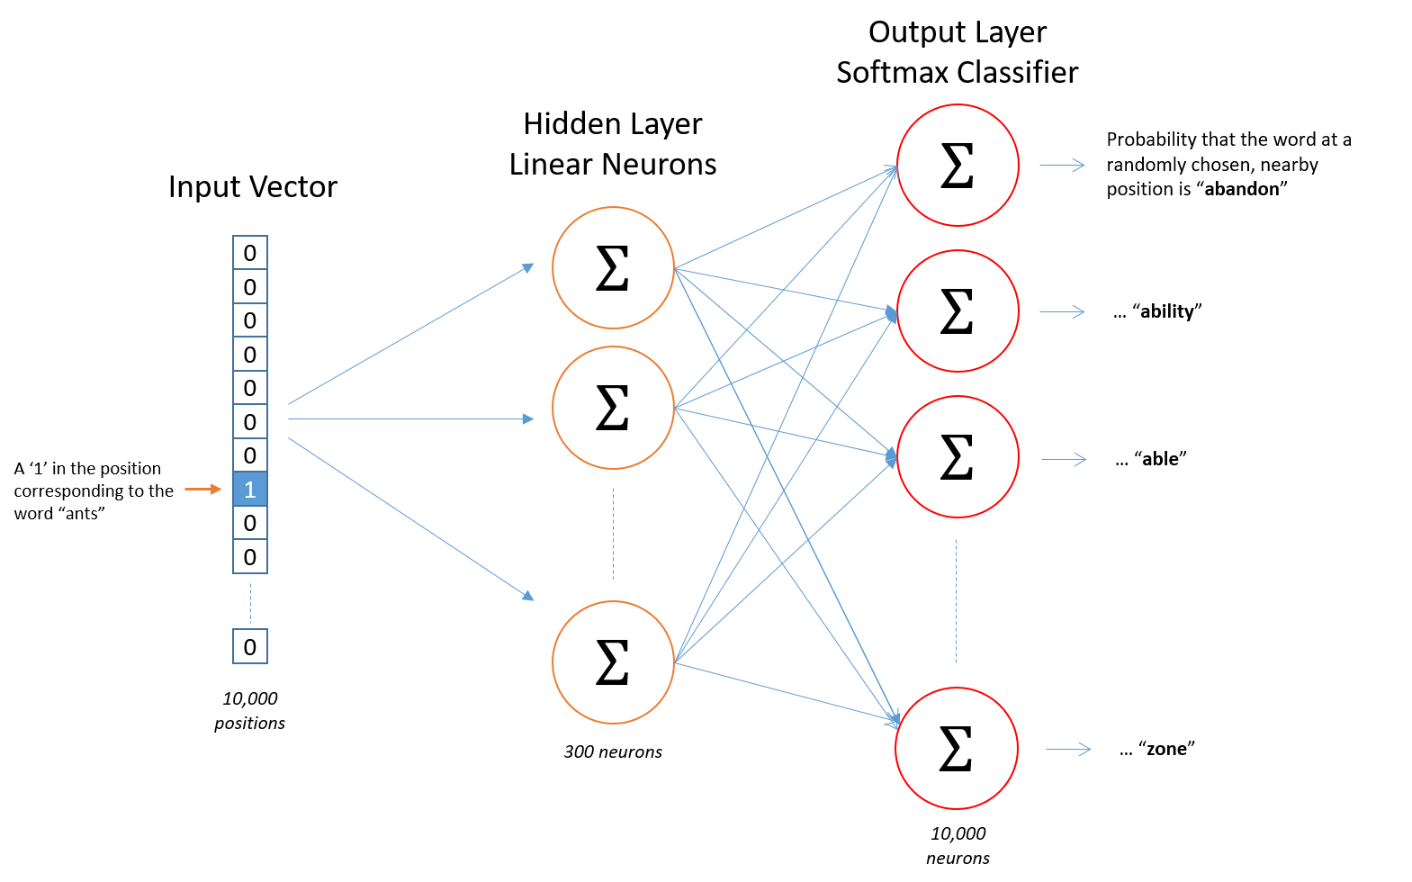
Language representation: skip gram

Slide 5
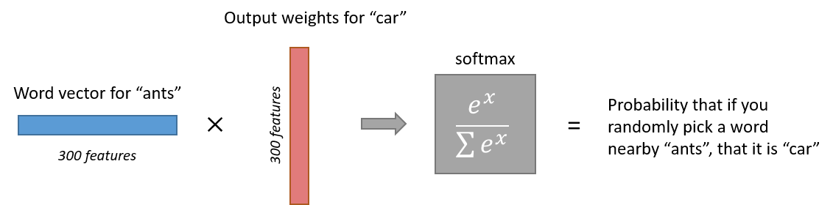
Language representation: skip gram

Slide 6
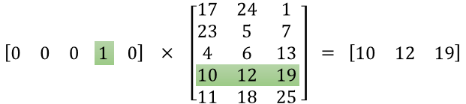
Language representation: skip gram

Slide 7
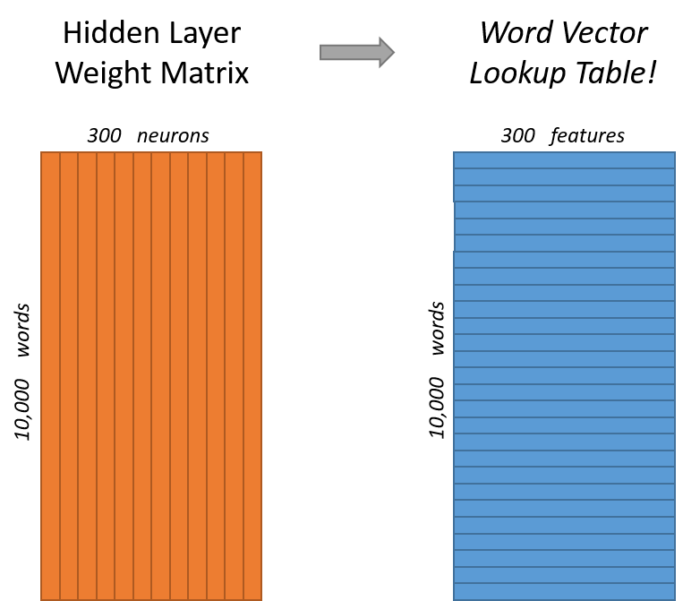
Language representation: skip gram

Slide 8
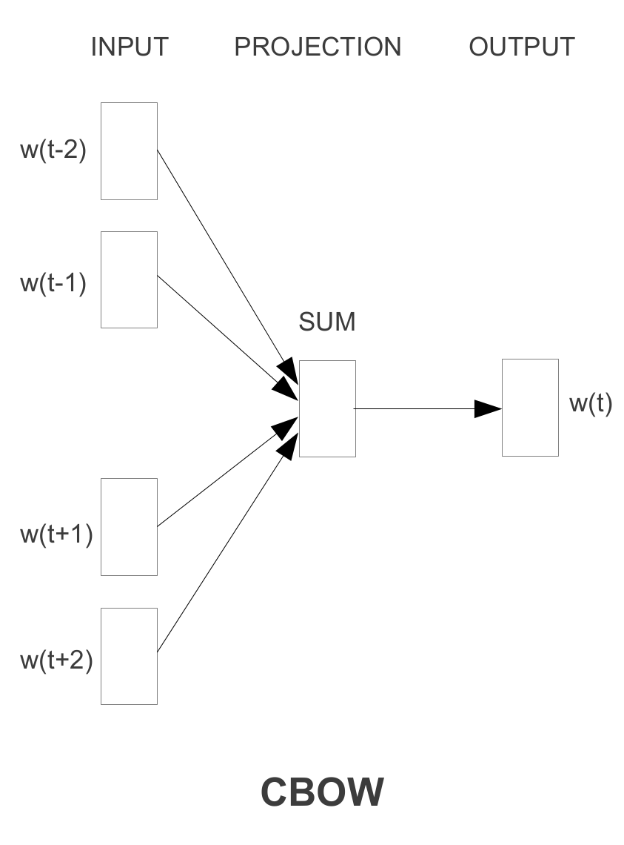
Language representation: CBoW

Slide 9
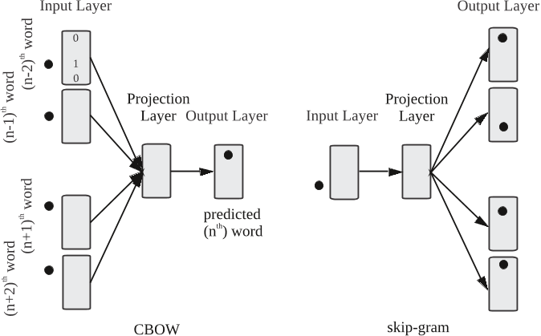
Language representation: CBoW vs skip gram

Slide 10
Language representation: CBoW vs skip gram

Slide 11
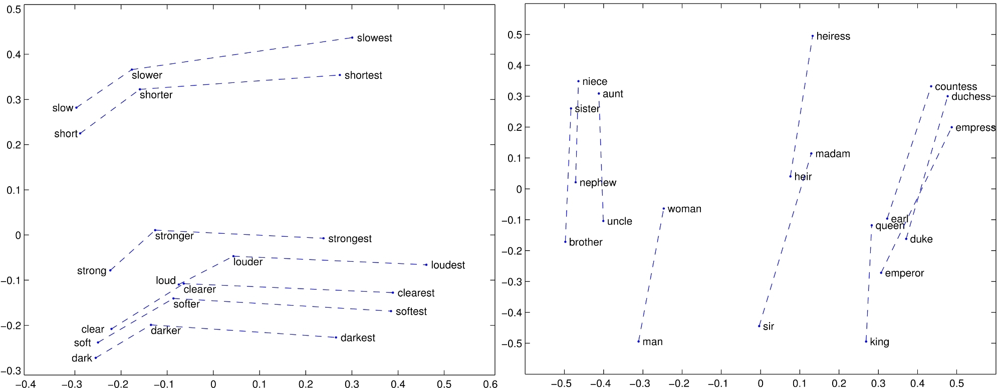
Language representation:

Slide 12
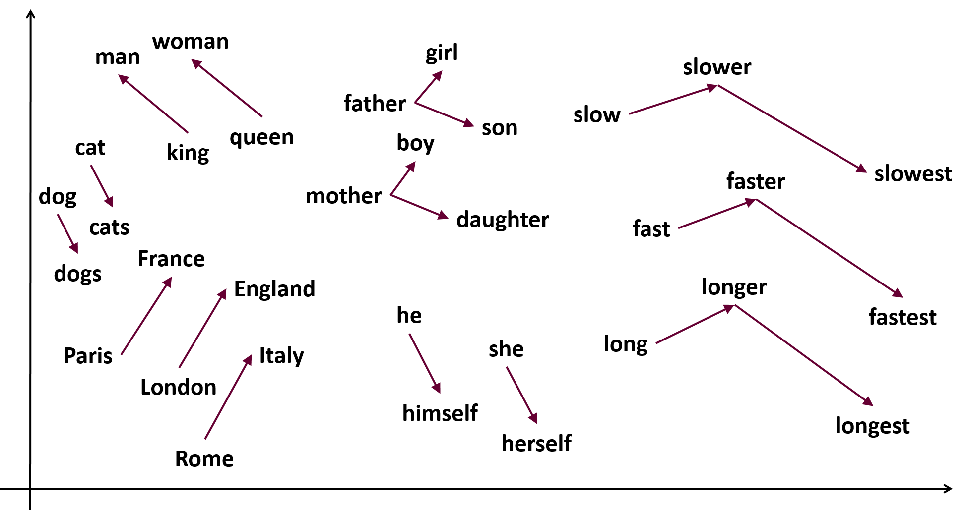
Language representation:

Slide 13
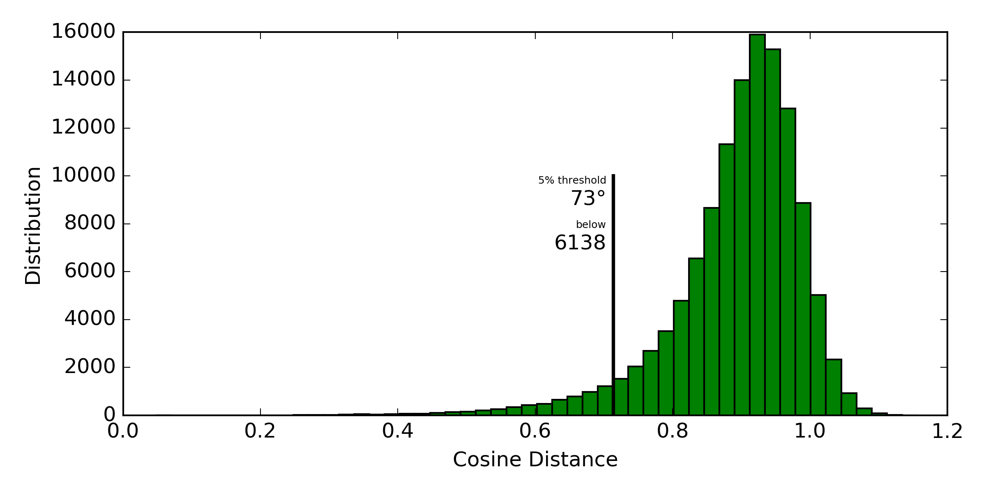
Language representation:

Slide 14
Language representation: DBOW (distributed bag of words)

Slide 15
Language representation: DM (distributed memory)

Slide 16
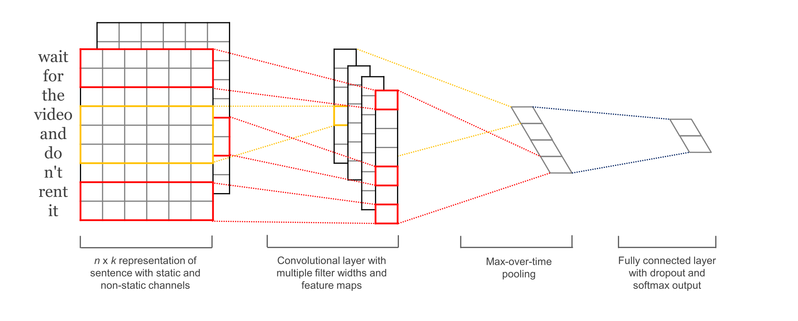
Language representation: convolutions over wv

Slide 17
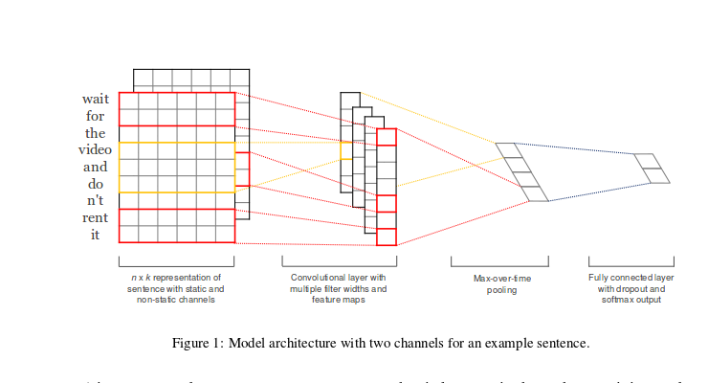
Language representation: multilayer convolutions

Slide 18
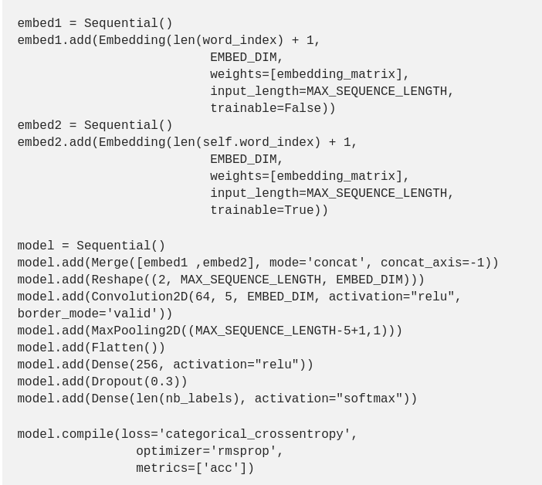
Language representation: multilayer convolutions

Slide 19
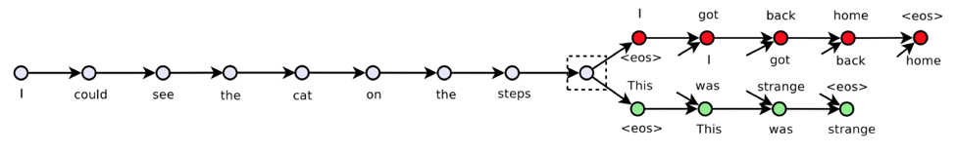
Language representation: Skip-thoughts

Slide 20
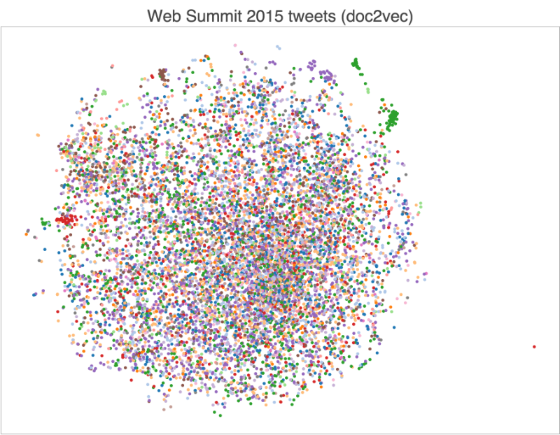
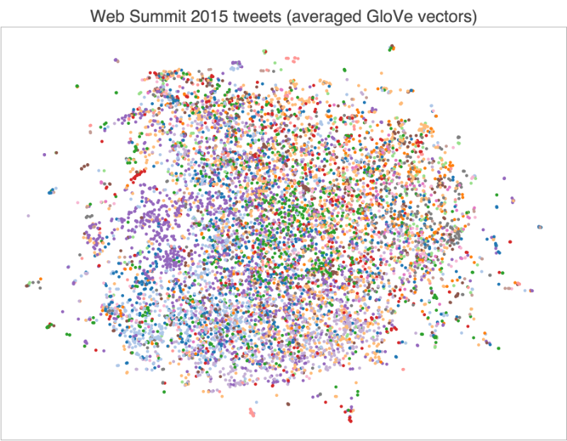
Language representation: Skip-thoughts

Slide 21
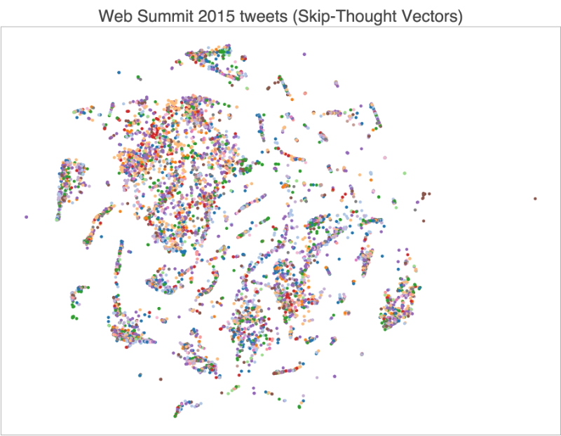
Language representation: Skip-thoughts

